Slide 1











Joint and Intersectoral Analysis Framework version 2.0
JIAF 2.0
Global Launch
A PEOPLE-CENTRED NEEDS ANALYSIS FOR EFFECTIVE HUMANITARIAN ACTION
3 August 2023

Slide 2
Leila Oliveira,
JIAF Senior Project Manager
JIAF 2.0 Overview

Slide 3
JIAF 2.0
Global Standards for joint and intersectoral analysis
Robust
Impartial
Transparent
Comparable
Replicable

Slide 4
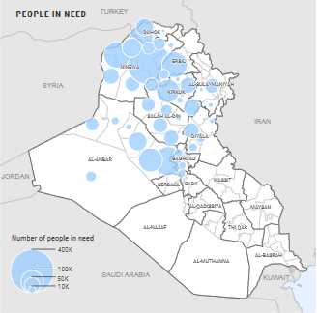
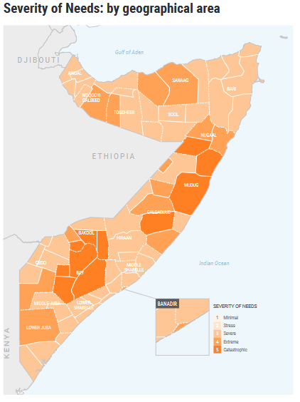
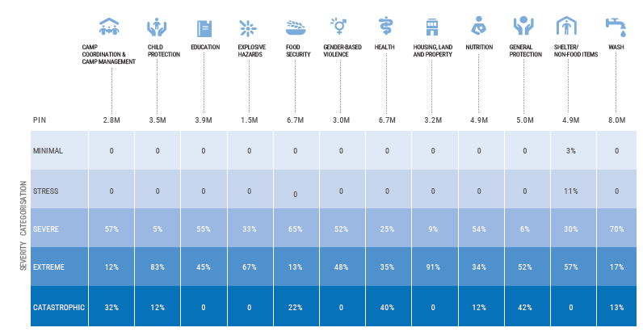
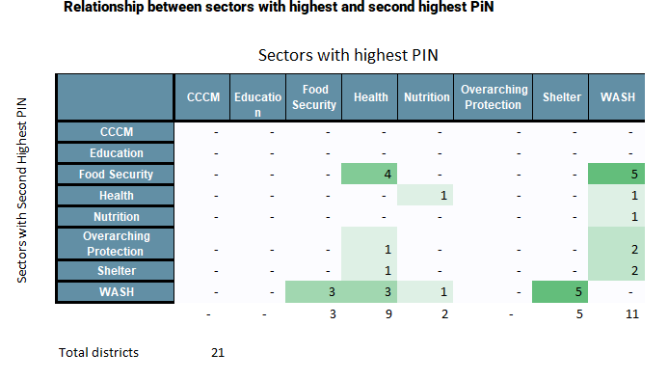
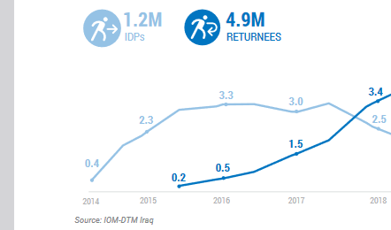
Core Information for Strategic Response
?
Magnitude of the crisis
Severity of the crisis
Interoperable sectoral needs
Linkages, overlaps and trends
Most affected populations and areas
Key drivers

Slide 5

Methodology
Using the best of quantitative and qualitative methods
1. CONTRIBUTING FACTORS & SCOPE
Toolkit 1
Context
Shocks & Impacts
Scope and implications for analysis
Identify common issues and scope
Finalize preliminary analysis
2. INTEROPERABLE SECTORAL NEEDS
3. INTERSECTORAL NEEDS
Toolkit 2
Toolkit 3
Sectoral PiN Interoperability
Sectoral Severity Interoperability
Intersectoral
Severity
Sectoral PiNs, severity and patterns inputs
Joint Overall PiN
Sector Specific Tools*
Cross-check,
reconciliation and alignment
Needs patterns
Food Security
Nutrition
Shelter
Spatial Patterns
Sectoral
Overlaps & Linkages
Trends
Protection&AoR
CCCM
Education
WASH
Health
Nutrition
* Sectoral Tool are not included as parts of JIAF Tools
* Sectors composition to be developed according to local context

Slide 6
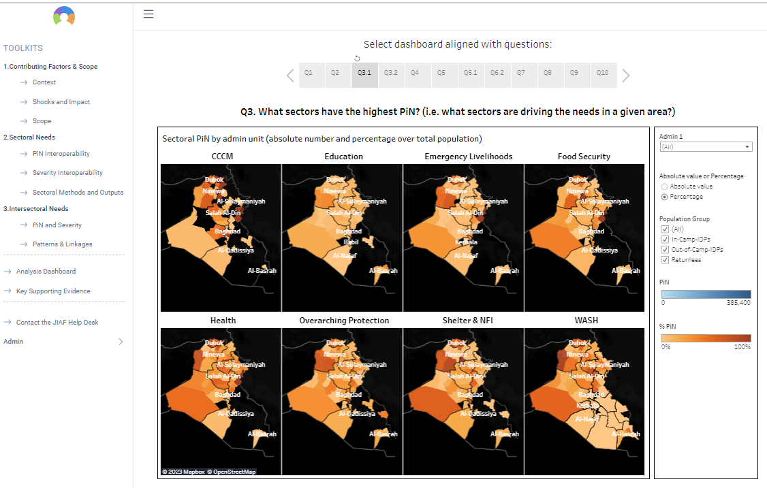

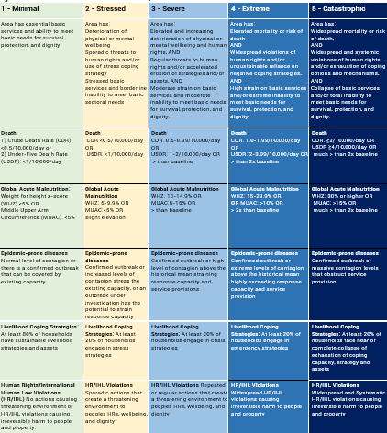
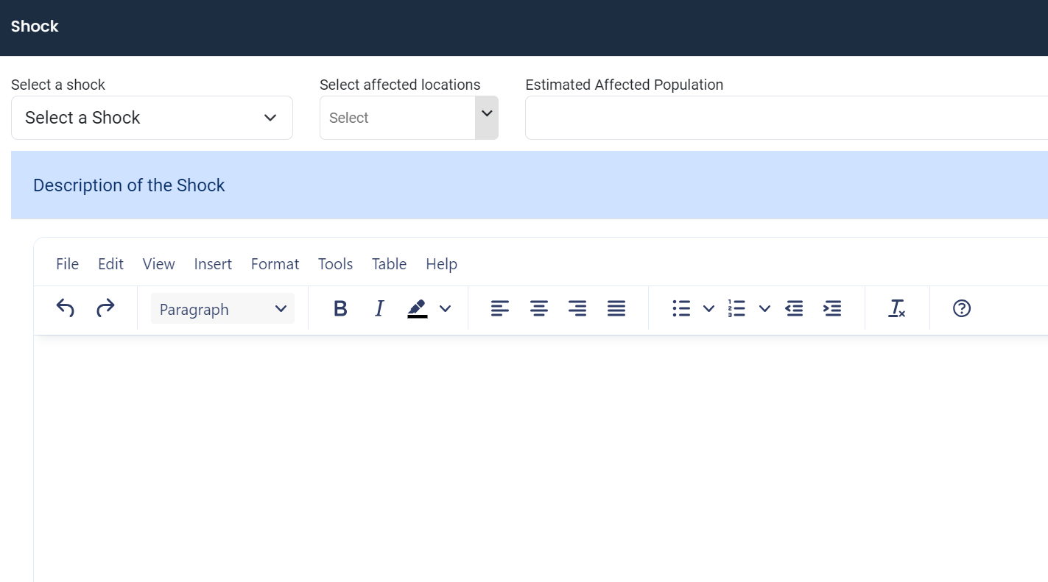
Analysis Platform
Includes all toolkits online to be used by country analysts
Reference tables
Workspaces ​
Includes visualization aids populated in real-time and evidence repository

Slide 7
Zola Dowell,
Chief, Needs Analysis and Response Section
OCHA
JIAF 2.0 Rollout and Country Support

Slide 8
Analysis Process in Country
Optional time for sectors to revise initial findings
Module 1
Contributing Factors and Scope
Module 2
Interoperable Sectoral Analysis
Module 3
Intersectoral Analyses
Joint working session
to identify common parameters and scope
Sectors conduct sectoral needs analyses, submit sectoral findings and methods
Joint working session(s) to examine sectoral analyses and conduct intersectoral analyses

Slide 9



Capacity Development
Each HPC country has at least one OCHA and one Cluster/Agency partner able to train and facilitate analysis
Regional partners to provide technical support
June – July training events
42
JIAF 2.0
Global Experts
111
Country and Regional Experts
820 +
Country Analysts
Staff with expert knowledge to
Provide technical support, co-facilitate country analysis and participate in quality assurance mechanisms
Ongoing and to be supported at country level
Country timelines
* OCHA maintains the roster of staff trained in the use of JIAF 2.0 at different levels.
Notes:
Only

Slide 10
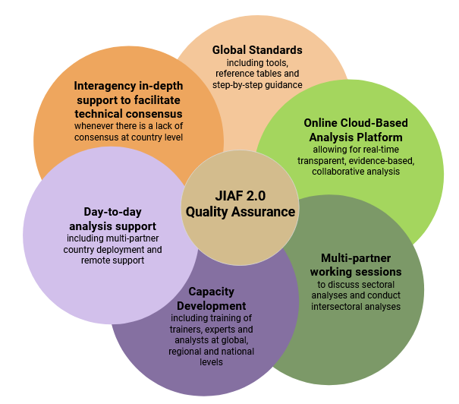
Quality Assurance and Country Support
Notes:
Quality of JIAF 2.0 analyses will ultimately result from a combination of different components.
Initial Foundation
technical standards and guidelines, including the JIAF 2.0 technical manual, with accompanying tools, and
capacity development processes, to ensure necessary technical and coordination knowledge and skills to conduct robust joint and inter-sectoral analysis using JIAF 2.0 standards.
During the rollout, analysts are supported by
Analysis platform, to support transparency, accountability, collaboration, etc
Multi-partner workshops, to enhance transparency , accountability, collaboration, etc
After the rollout, and during the JIAF 2.0 analysis process, remote mechanisms will be available to ensure that country analysts adhere to JIAF 2.0 technical standards to produce a rigorous and impartial needs analysis:
- Day to day technical troubleshooting: OCHA and global clusters will provide day-to-day technical troubleshooting to the respective counterparts at country level.
- In-depth support for contentious analyses: A global help-desk, coordinated by OCHA, will provide remote in-depth support to be activated ad hoc when there is a break in consensus at country level on the implementation of JIAF 2.0 guidance, methods and processes.
Focus on the JIAF Helpdesk (more deatiles
Membership and Chair: The Helpdesk is composed of technical focal points from the JIAF Methodology Working Group, including all global level clusters, OCHA, other UN agencies and NGOs. OCHA will chair the helpdesk.
Helpdesk activation: Every new request is logged in the JIAF Helpdesk Tracker. OCHA is responsible for logging all information related to requests for in-depth support as soon as received. OCHA is also responsible for calling in the HelpDesk to assess the request and confirm if an inter-agency in-depth support should be activated or if the query can be answered through clarification of technical methodologies. If the interagency in-depth support is activited, the helpdesk will conduct a series of discussions with country team and will provide recommendations to the Humanitarian Country Team.
The helpdesk tracker: The tracker is accessible real-time and is open to all members of the JIAF governance bodies, including members of the Joint Advisory Group and the Steering Committee. The Joint Advisory Group will be notified when new interagency in-dept support has been initiated. The help desk will log real time information on the query, the solution provided by the Helpdesk, and the action taken at country level following the guidance from the Helpdesk.
Helpdesk Accountability: The Helpdesk Chair will share quarterly summaries of key issues being raised and how they are being resolved. The Helpdesk team is responsible for updating online FAQs which are accessible to all HPC countries via the jiaf.info website.

