Slide 1







Joint
Intersectoral Analysis
Framework
A PEOPLE-CENTRED NEEDS ANALYSIS FOR EFFECTIVE HUMANITARIAN ACTION

Slide 2


Slide 3
JIAF 1.1 – Training Plan
The Plan is composed of 3 elements:
4 High-level pre-recorded presentations of 20 min max (Overview of the JIAF, the Concept, the Methodology and the Process).
  Available end May 2021
8 more in-depth blended sessions (ie approx. 40min, with exercises/templates etc) – also pre-recorded. These will be available in June.
  Available June 2021
Workshops / Webinars

Slide 4
JIAF 1.1 – Training Plan
4 high level 20-min (max) pre-recorded presentations:
[HL1] JIAF Overview (Concept, Methodology, Process)
[HL2] JIAF Concept
[HL3] JIAF Methodology
[HL4] JIAF Process
8 in-depth blended pre-recorded presentations + exercises/tools (ie approx. 40min, with exercises/templates etc)
[BL1] Methodology / Framework,
[BL2] Methodology / Indicators and Severity,
[BL3] Methodology / Aggregation and PIN
[BL4] Process / Coordination set-up
[BL5] Process / Step-by-Step
[BL6] Best practices from JIAF 1.1
[BL7] Overview: JIAF for Inter-Cluster Coordinators and OCHA HPC focal Points
[BL8] Overview: JIAF for in country Cluster coordinators

Slide 5
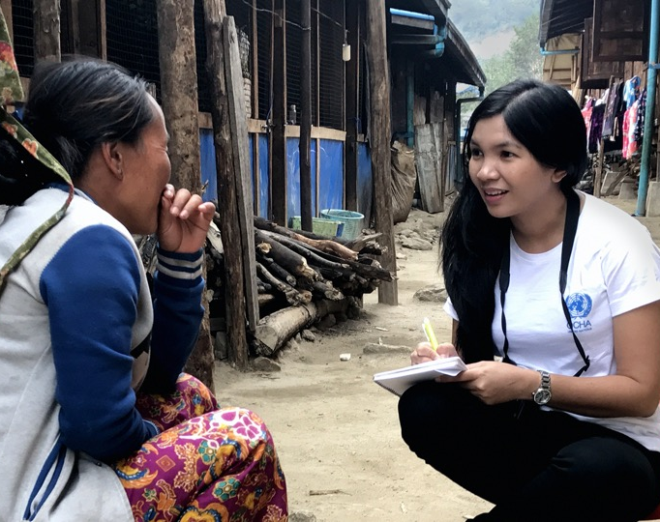
Methodology

Slide 6
The jiaf approach
The JIAF is an approach to analyze the inter-sectoral needs of populations in crisis, with 3 components:
A concept: joint intersectoral analysis rather than multi-sectoral, with affected people as the starting point
A methodology: An analytical framework that gives a structure to how the information about the challenges faced by affected populations is organized, classified, processed, treated, aggregated, visualized to help make sense of it.
A process:
  Propose a plan that adapts the standard methodology to country-specific reality,
  Collect the data, and organize it as per the plan agreed to in Step 1,
  Consolidate the information,
  Analyze jointly,
  Validate results.

Slide 7
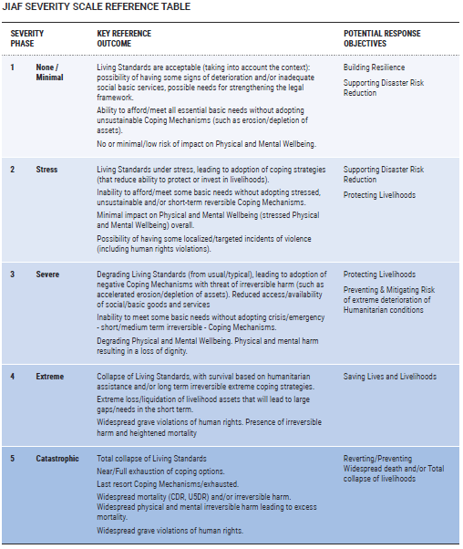
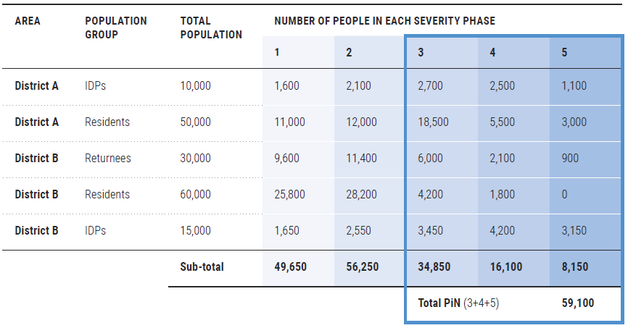
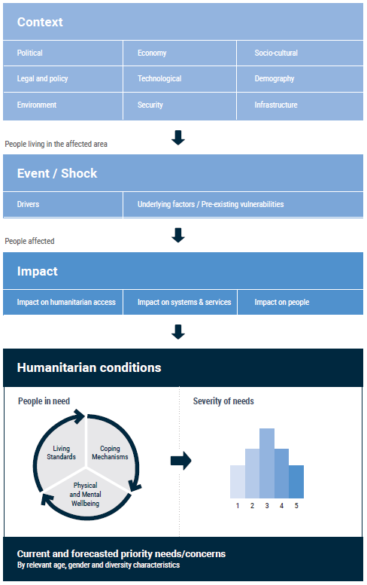
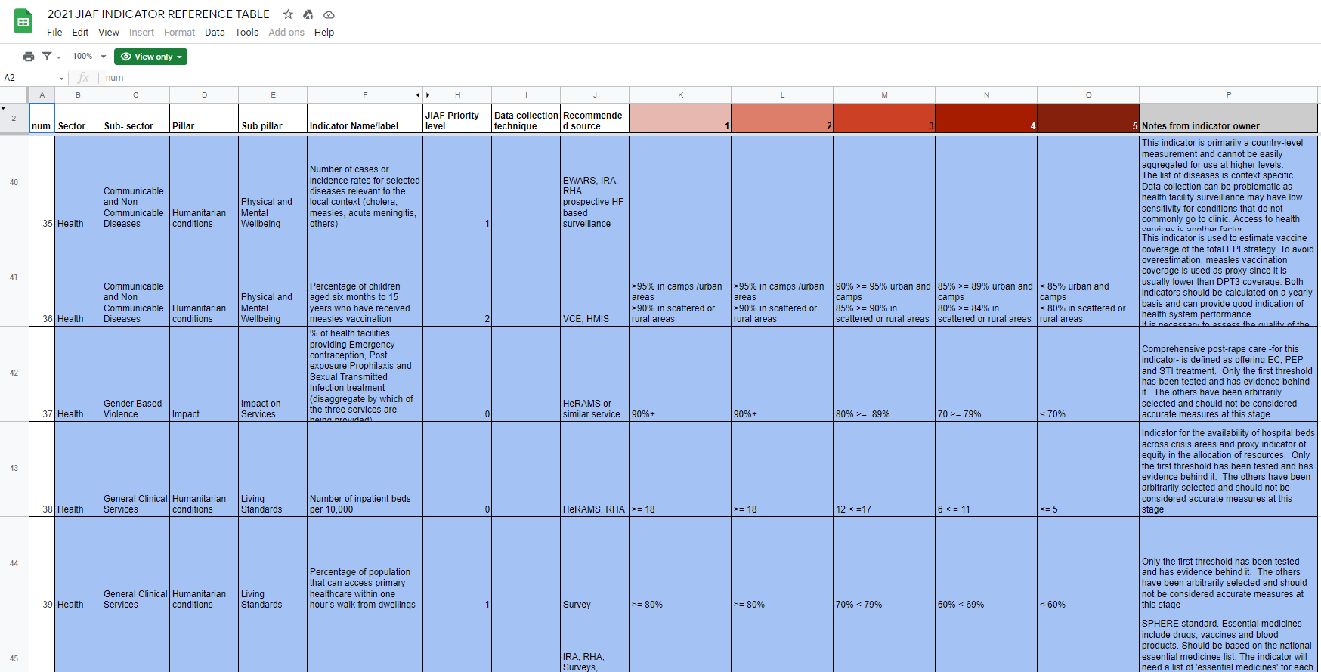
Jiaf > The approach > The methodology
  An analytical framework that gives a structure to how the information about the challenges faced by affected populations is organized, classified by severity, processed, treated, aggregated, visualized to help make sense of it.
Framework
Indicators
Aggregation

Slide 8
Jiaf > The approach > The methodology > the framework
The JIAF is built around five pillars
Each contains different subpillars.
This serves to organize information, visualize relationships and bring a consistent structure to the analysis.
The JIAF Conceptual framework helps frame the story of a population affected by a shock in a consistent and comprehensive manner.
Notes:
The JIAF is built around five main pillars, each of which contains different subpillars.
The main purpose of pillars and subpillars is to help organise information, visualize relationships and bring a consistent structure to the analysis.
Put simply, the JIAF should help tell the story about how a population has been affected by a shock or stress in a consistent and comprehensive manner.

Slide 9
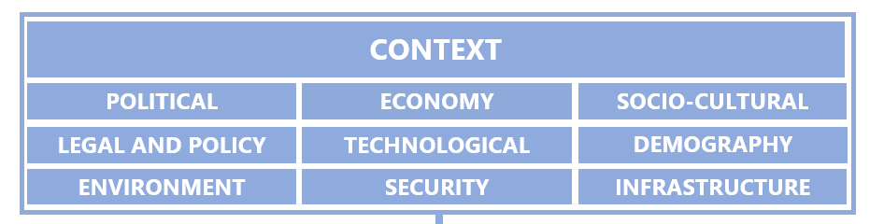
Jiaf > The approach > The methodology > the framework
Relevant characteristics of the Area Of Interest
General characteristics of the political, socio-cultural, economic, legal & policy, technological, demographic, security, infrastructure and environmental conditions.
Example:
  Remittances contribute 10% to the GDP of S Sudan ….
  Roads outside the capital are unpaved …
Notes:
Note that you should try to have all info in each Pillar of the Framework disaggregated at the unit of analysis you are using.. I.e Admin 2, IDP / Host, etc. where relevant, and possible.

Slide 10
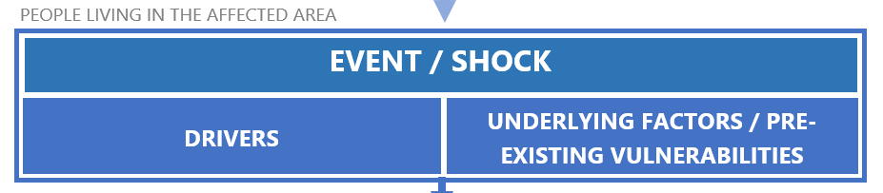
Jiaf > The approach > The methodology > the framework
An event/condition that disrupts the functioning of a community or society and causes human, material, and economic or environmental losses.
should be localized geographically as to allow an estimation of the number of people living in the affected area, as defined in the 2016 IASC Humanitarian Profile Support Guidance.
Examples:
  Conflict within the line of contact; intensity, extents
  Earthquake – magnitude, exposure, extents
Notes:
….UF subpillar is space to talk about WHY it is a shock.

Slide 11
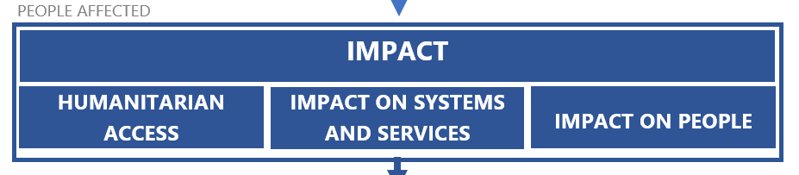
Jiaf > The approach > The methodology > the framework
The primary effects of the event/shock on the population, systems and services in the affected area
Impact on people - losses and damages to assets and capital, displacement, violence, mobility issues and livelihood, etc.
Impact on systems - damages to infrastructure or means of communication, disruption of social cohesion, markets, services, etc.
Impact on humanitarian access -obstacles or challenges for People in Need to access relief actors, for relief actors to access People in Need and other physical constraints.
Notes:
Examples:
Impact on People: Internal Displacement – numbers, locations (from / to) etc.
Impact on Systems: damage to communication infrastructure
Impact on Access – cut off communities, bureaucratic impediments, etc.

Slide 12
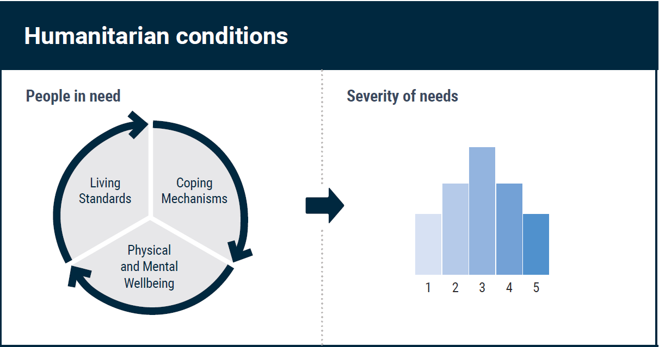
Jiaf > The approach > The methodology > the framework
The consequences of the shock’s impacts on the population
identified in magnitude, analyzed in terms of severity
Notes:
The Humanitarian Conditions Pillar is where the consequences of the shock/event’s impact on people are identified in terms of magnitude and analyzed in terms of severity. The severity of Humanitarian Conditions is estimated by taking into account three humanitarian consequences (subpillars, in the JIAF):

Slide 13
Jiaf > The approach > The methodology > the framework
The severity of Humanitarian Conditions is
estimated by taking into account three levels of consequences:
Living standards: Ability of the affected population to meet their basic needs for essential goods and services.
Coping mechanisms: Degree to which people are coping or facing challenges with impact recovery. Coping mechanisms can be positive or negative.
Physical and Mental Wellbeing: Measured by assessing the physical health of the affected population as well as its mental wellbeing, excess morbidity or mortality, malnutrition, psychosocial trauma, grave human rights violations.

Slide 14
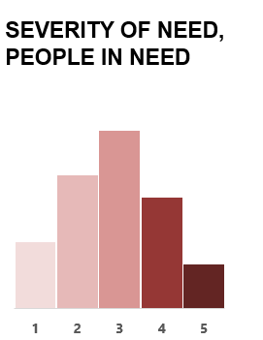
Jiaf > The approach > The methodology > the framework
Severity for the HC Pillar is aggregated, distributed across the population at the units of analysis and the crisis level
Severity is ‘thresholded’ to establish Intersectoral PiN
Sub-Pillar PiN is not recommended / endorsed due to the interrelated nature of the sub-pillars
2. COPING MECHANISMS
3. PHYSICAL & MENTAL WELLBEING
1. LIVING STANDARDS
SEVERITY OF NEED, PEOPLE IN NEED

Slide 15
Jiaf > The approach > The methodology > the framework
SHOCK
The Humanitarian Conditions subpillars are all interrelated.
The JIAF analysis is framed within an ‘analysis period’ for a given crisis, and for this analysis period, the unit of analysis is geographic areas and affected populations (sub-district, IDPs for example).
The Humanitarian Conditions Subpillars can (but not always) be seen as a cycle, following a shock and its impact:
  From having no problems, to having some issues with addressing basic needs, to engaging in increasingly negative coping strategies, ultimately leading to negative effects on their wellbeing.
Feedback loops within one pillar, or between two can also be present – the progression is not always circular as described and many processes can be occurring simultaneously.
IMPACT
LIVING STANDARDS
COPING MECHANISMS
PHYSICAL & MENTAL WELLBEING
1.
2.
3.
Notes:
Note that the Humanitarian Conditions subpillars are all interrelated and the progression of humanitarian consequences does not always follow a linear sequence from the inability to access basic goods or services to the adoption of negative coping mechanisms and finally the impact of the previous on physical and mental well being.
Feedback loops exist between the three sub pillars and each can contribute to negative outcomes in the other, e.g. disabilities or malnutrition can in turn lead to challenges in accessing basic goods and services, etc. Since it is difficult to understand what exactly precedes and contributes to what, attempts to understand causality effects between the humanitarian conditions sub pillars are not recommended.
The severity in one subpillar taken individually or in isolation of other sub pillars is also not recommended for use, as it provides only a partial picture of people’s humanitarian conditions. For instance, a population group can present a good level of access to basic goods or services (living standards subpillar), but only because they started to engage in negative and irreversible coping strategies (coping mechanisms subpillar). Taken individually, the living standards severity score can also be easily misinterpreted. Only the three sub pillars taken together and aggregated into a final Humanitarian Condition narrative and score can reflect on the overall humanitarian conditions and their severity.

Slide 16
Jiaf > The approach > The methodology > the framework
Measuring intersectoral severity is a central function of the JIAF
Achieved by applying the JIAF severity model, supported by the set JIAF Severity Scale
All the indicators used in assessing the Humanitarian Conditions are scaled.
The scales refer to the definitions overall seen here.
When executed to its fullest potential, the methodology enables distribution of the total number of people in an area or affected group across the five severity classes.
Notes:
Measuring intersectoral severity (the degree of harm brought by all combined humanitarian consequences) is a central function of the JIAF and is achieved by applying the JIAF severity model, supported by the set JIAF Severity Scale
All the indicators used in assessing the Humanitarian Conditions are scaled. The scales refer to the definitions overall seen here.

Slide 17
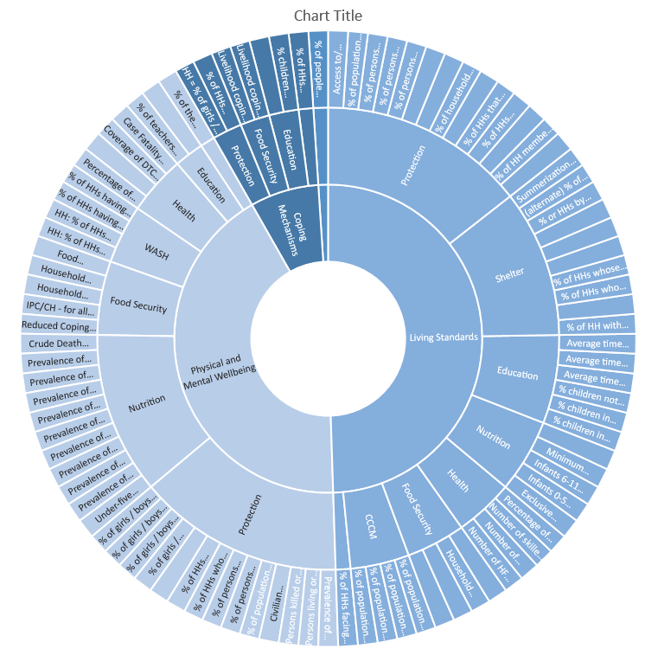
JIAF Indicators
Notes:
In total, there are 123 indicators in the reference table, with 97 indicators supporting the Humanitarian Conditions pillar

Slide 18
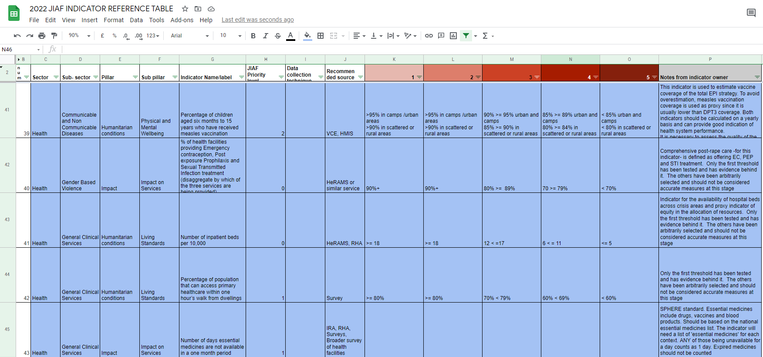
Jiaf > The approach > The methodology > the indicators

Slide 19
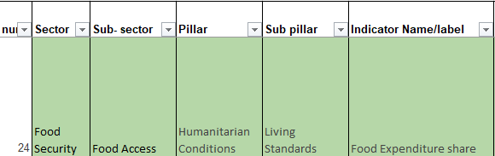
Jiaf > The approach > The methodology > the indicators

Slide 20
Jiaf > The approach > The methodology > the indicators

Slide 21
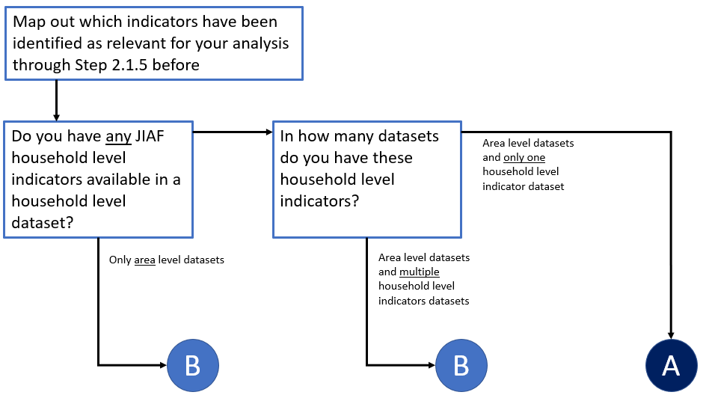
Jiaf > The approach > The methodology > the aggregation
Notes:
Two scenarios (A and B) have been identified, for aggregation of indicators in the humanitarian conditions pillar, to obtain the initial, estimated JIAF PiN calculations.
The scenarios are determined based on the availability of JIAF indicator data, in particular whether data is available at household and/or area level.
Data Scenario A is easier to implement, more precise and allows for a full breakdown of population by severity class, which is not possible for Data Scenario B.
However, scenario A shouldn’t be pushed, and no data should be discarded. If you have multiple data sources, and indicators are unlinked, you must use Scenario B
Sectors can chose to recommend non MSNA data source and this should not encourage MSNAs – see guidance under 2.2.4 “if a specific JIAF household level indicator has multiple sources (e.g., MSNA and sector-specific assessment), the concerned sector should be able to decide which source should be used for that indicator (based on reliability, etc.)”

Slide 22
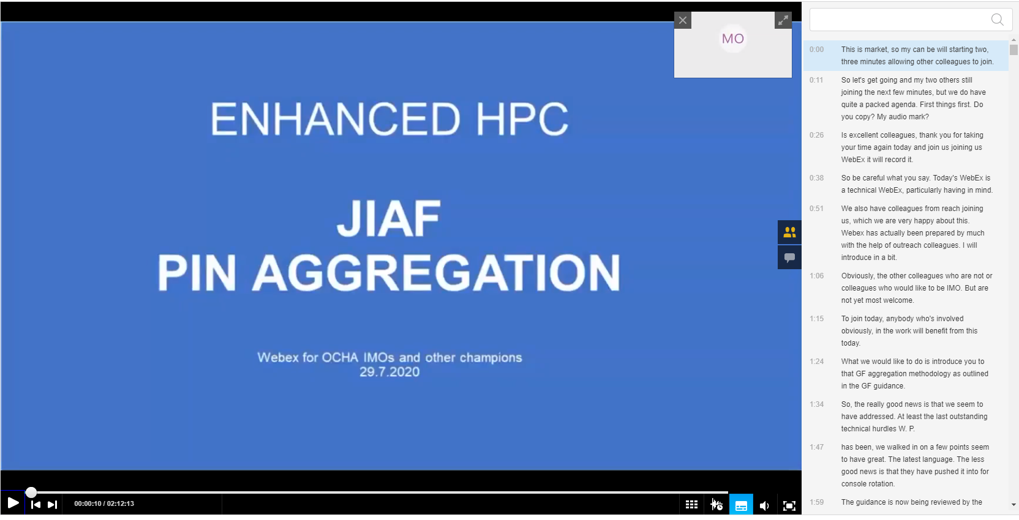
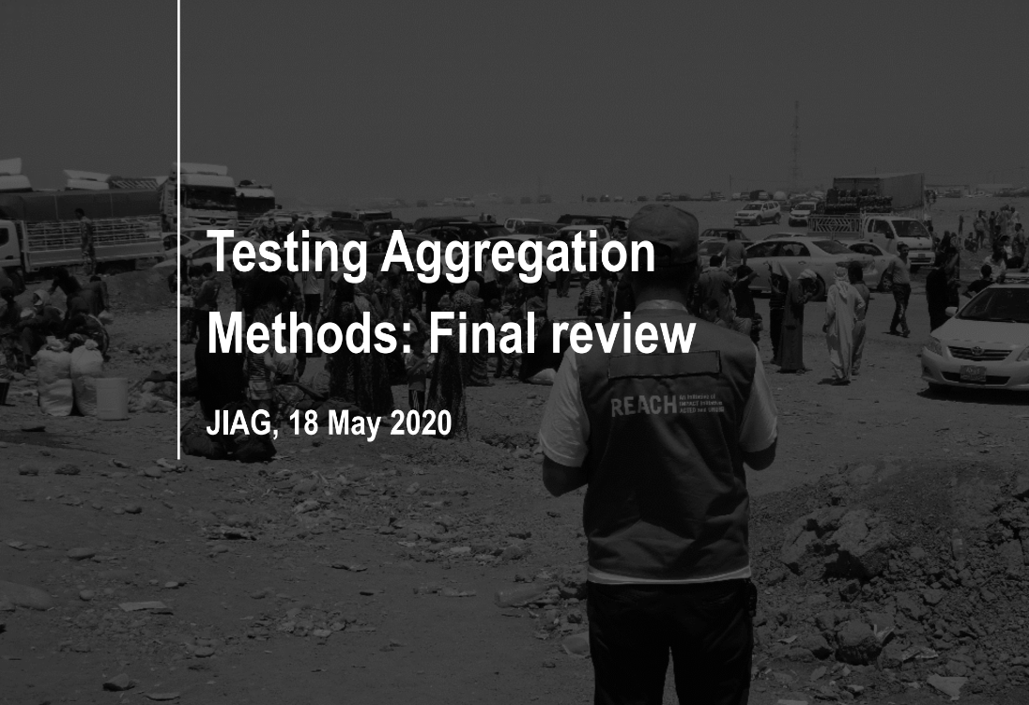
Jiaf > The approach > The methodology > the aggregation

Slide 23
Links
JIAF and HPC
HPC 2022 Facilitation Package
JIAF 1.1 Guidance
Methodology
Framework: 2017 Analytical Framework Review Report
Indicators: JIAF Indicator Reference table
Aggregation:
  Testing Aggregation Methods: Final review by REACH

Slide 24
THANK YOU

