Slide 1








Joint
Intersectoral Analysis
Framework
A PEOPLE-CENTRED NEEDS ANALYSIS FOR EFFECTIVE HUMANITARIAN ACTION
Notes:
Welcome to module 2 of JIAF recorded Induction Package
Introduction narrator

Slide 2


Slide 3
JIAF CONCEPT
2nd of 4 training modules
21.5.2021
Notes:
This module is the 2nd of 4 modules explaining in a bit more depth the JIAF Concept
Module 1 provided a broad overview of the JIAF approach
Module 3 will take a closer look at the JIAF methodology
And the last and 4th module will discuss the key steps of the JIAF process
Each module is about 20min short. Together they constitute a non-technical Induction Package. More advanced technical training material is available on the JIAF website and OCHA’s Knowledge Management Platform.

Slide 4
JIAF 1.1 – Training Plan
The Plan is composed of 3 elements:
4 High-level pre-recorded presentations of 20 min max (Overview of the JIAF, the Concept, the Methodology and the Process).
  Available end May 2021
8 more in-depth blended sessions (ie approx. 40min, with exercises/templates etc) – also pre-recorded. These will be available in June.
  Available June 2021
Workshops / Webinars

Slide 5
JIAF CONCEPT:
Multi- vs Intersectoral
Key elements JIAF approach
Conceptual Framework
Indicators
PiN Aggregation
Notes:
The structure of this module is as follows
Multi- vs Intersectoral
Key elements JIAF appraoch
Conceptual Framework
Indicators
PiN Aggregation

Slide 6








Inter- vs multisectoral
FoodSec
Protection
WaSH
Health
Nutrition
Shelter
Education
Notes:
Multi-sectoral: listing or grouping sectoral issues without looking at their interconnections or overlaps – or trying to understand how they all come together in the same unit of analysis such as e.g. vulnerable group.
Inter Sectoral Cross sectoral: Approaches that highlight the importance of system thinking and considering issues as a whole, across sectors, and the range of factors that collectively influences humanitarian conditions or how situations in one sector influences or impact upon one or more other sector.
The purpose of intersectoral analysis is to help build synergies across sectors so as to tackle complex issues for achieving inter-related humanitarian/development goals and targets

Slide 7

Inter- vs multisectoral
Notes:
The analytical outputs of the JIAF should help understand the inter-relationship between sectoral problems, their overlaps, commonalities and differences manifested in the most vulnerable groups
As opposed to a disjointed narrative without common unit of analysis where sectoral issues are being unpacked in isolation or loosely grouped under thematic headers.
People don’t run their family in cluster thematics, they articulate their needs as a whole
The problematic becomes clear if one looks at older HNO – Humanitarian Needs Overviews – which featured often lengthy narrative with one sectoral problem listed after another.
This has improved in more recent HNOs with the help of the JIAF. I encourage you to look at compare recent HNO – in particular the sections 1.4 where the humanitarian conditions are being analysed.

Slide 8
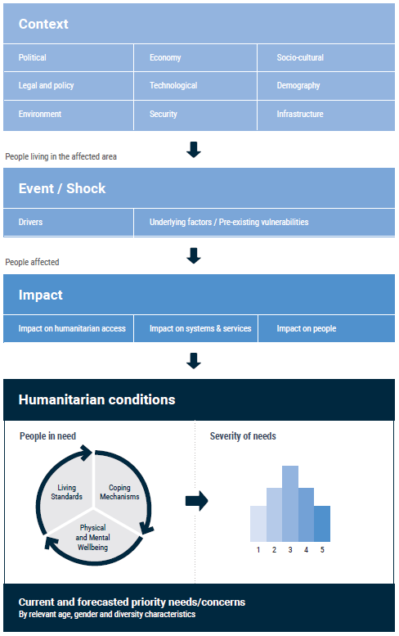
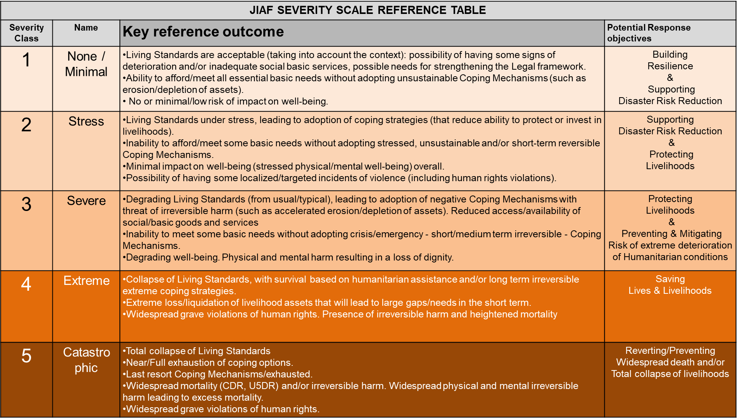
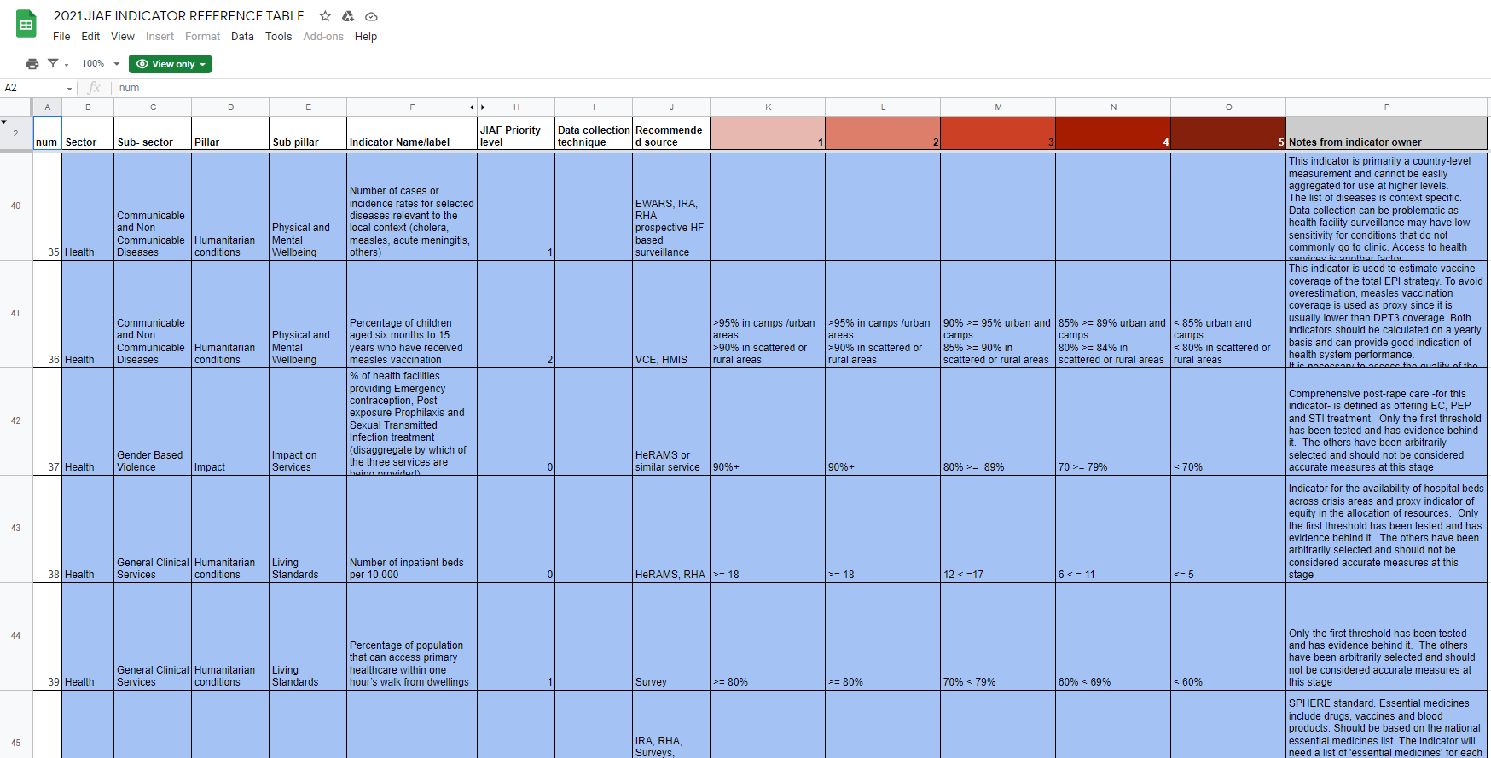
Key Elements
Conceptual Framework
Severity Model
Notes:
Analytical Framework
indicators with standardized severity thresholds
PiN aggregation

Slide 9
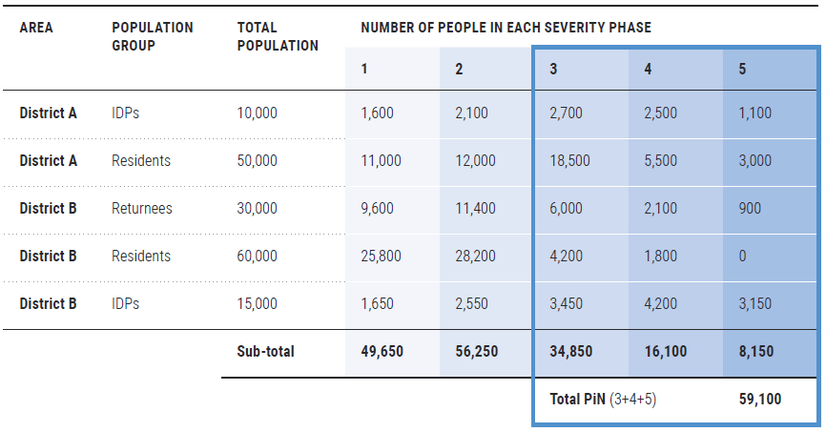
Key Elements
Framework
Severity Model
Aggregation
Notes:
Analytical Framework
indicators with standardized severity thresholds
PiN aggregation

Slide 10
Conceptual Framework
Notes:
Description of the pillars:
The JIAF is built around five pillars
Each contains different subpillars.
This serves to organize information, visualize relationships and bring a consistent structure to the analysis.
The JIAF Conceptual framework helps frame the story of a population affected by a shock in a consistent and comprehensive manner.
The first three pillars – context, event/shock, and impact – allow response actors to define the scope of the crisis, i.e., to identify all affected geographic areas and estimate the total number of people who have been affected by it, disaggregated by key demographic characteristics.
First pillar: Context: Describes relevant characteristics of the Area Of Interest
9 subpillars: political, socio-cultural, economic, legal & policy, technological, demographic, security, infrastructure and environmental conditions.
Example: Remittances contribute 10% to the GDP of S Sudan ….Roads outside the capital are unpaved …
Second pillar: Looks at events/conditions that disrupts the functioning of a community or society and causes human, material, and economic or environmental losses.
Distinguishes between Drivers + underlying factors
Examples: Conflict within the line of contact; intensity, extents… Earthquake – magnitude, exposure, extents
Third pillar: Looks at the event/shock on the population, systems and services in the affected area
Impact on people - losses and damages to assets and capital, displacement, violence, mobility issues and livelihood, etc.
Impact on systems - damages to infrastructure or means of communication, disruption of social cohesion, markets, services, etc.
Impact on humanitarian access -obstacles or challenges for People in Need to access relief actors, for relief actors to access People in Need and other physical constraints.
The fourth pillar - the Humanitarian Conditions Pillar - is where the consequences of the shock/event’s impact on people are identified in terms of magnitude and analyzed in terms of severity. The severity of Humanitarian Conditions is estimated by taking into account three humanitarian consequences (subpillars, in the JIAF):
The fifth pillar applies a forward-looking lens, to project needs based on the most likely evolution of the crisis during the planning period. This forecasting will also include projecting how needs may change in the absence of assistance that is currently being provided.

Slide 11
Conceptual Framework
Notes:
Zoom in Humanitarian Conditions Pillar:
The Humanitarian Conditions subpillars are all interrelated.
The progression of humanitarian conditions does not always follow a linear sequence from the inability to access basic goods or services to the adoption of negative coping mechanisms and finally the impact of the previous on physical and mental well being.
Feedback loops exist between the three sub pillars and each can contribute to negative outcomes in the other, e.g. disabilities or malnutrition can in turn lead to challenges in accessing basic goods and services, etc.
Since it is difficult to understand what exactly precedes and contributes to what, attempts to understand causality effects between the humanitarian conditions sub pillars are not recommended.
The severity in one subpillar taken individually or in isolation of other sub pillars is also not recommended for use, as it provides only a partial picture of people’s humanitarian conditions.
For instance, a population group can present a seemingly good level of access to basic goods or services (living standards subpillar), but only because they started to engage in negative and irreversible coping strategies (coping mechanisms subpillar).
Only the three sub pillars taken together and aggregated into a final Humanitarian Condition narrative and score can reflect on the overall humanitarian conditions and their severity.

Slide 12
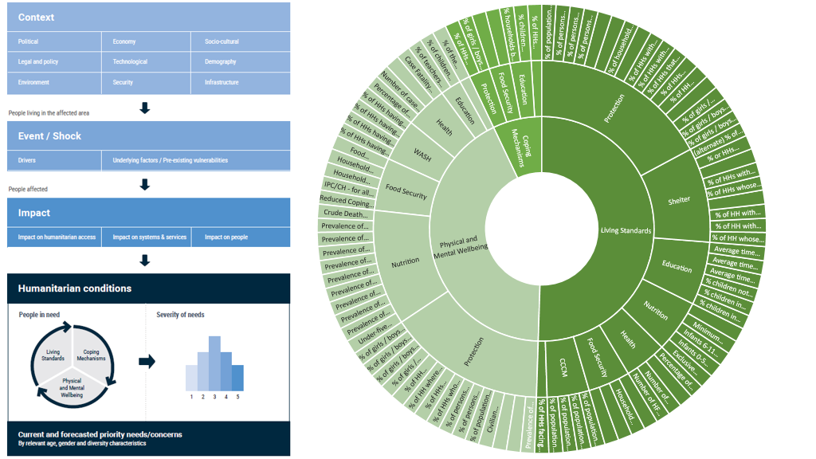
Indicators
Notes:
2022 JIAF INDICATOR REFERENCE TABLE - Google Tabellen
Measuring intersectoral severity (the degree of harm brought by all combined humanitarian consequences) is a central function of the JIAF and is achieved by applying the JIAF severity model, supported by the set JIAF Severity Scale
All the indicators used in assessing the Humanitarian Conditions are scaled. The scales refer to the definitions overall seen here.

Slide 13
Indicators
Notes:
In total, there are 116 indicators in the reference table, with 99 indicators supporting the Humanitarian Conditions pillar

Slide 14
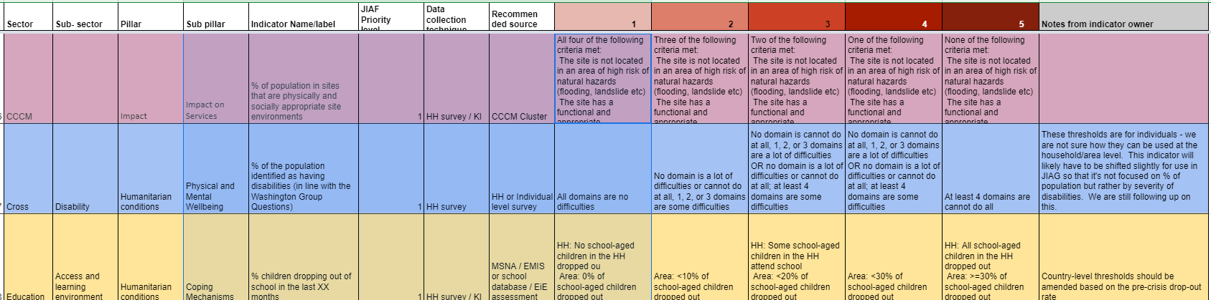
Indicators
Notes:
This how the indicators are detailed

Slide 15
PiN Aggregation
2 Scenarios
A
B
PiN = People in Need
Notes:
There are two scenarios (A and B) for aggregation of indicators in the humanitarian conditions pillar, to obtain the initial, estimated JIAF PiN calculations.

Slide 16
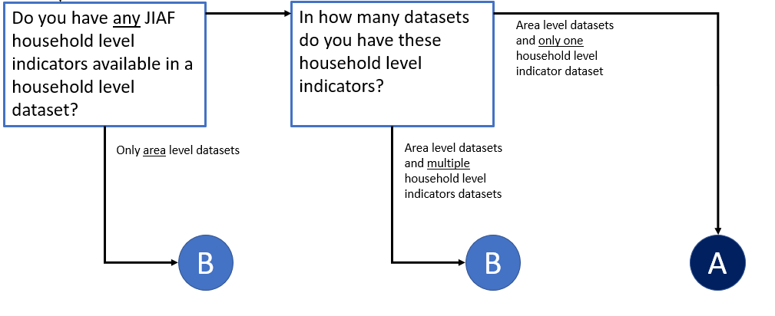
PiN
Notes:
The scenarios are determined based on the availability of JIAF indicator data, in particular whether data is available at household and/or area level.
Data Scenario A is easier to implement, more precise and allows for a full breakdown of population by severity class, which is not possible for Data Scenario B.

Slide 17
PiN
Notes:
The PiN aggregation will be further explained in module 3 and in a dedicated technical module as part of the more advanced training package

Slide 18
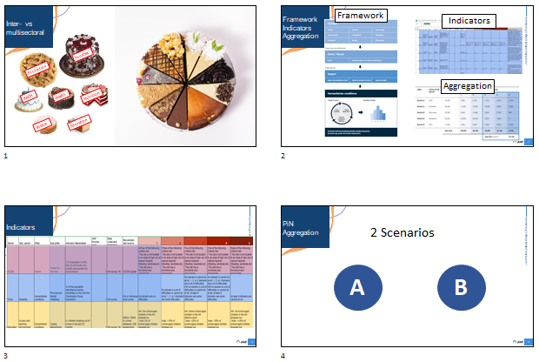
THANK YOU
1. Multi- vs Intersectoral 2. Key elements JIAF approach
3. Indicators 4.PiN Aggregation
Notes:
End of module
Brief recap

Slide 19
THANK YOU

